Slide 1
<number>
Innovation Laboratory
Yield prediction for Carmen Rosa farm
Diego Alarcón
diego_alonso.alarcon_diaz@stud-mail.uni-wuerzburg.de

Slide 2
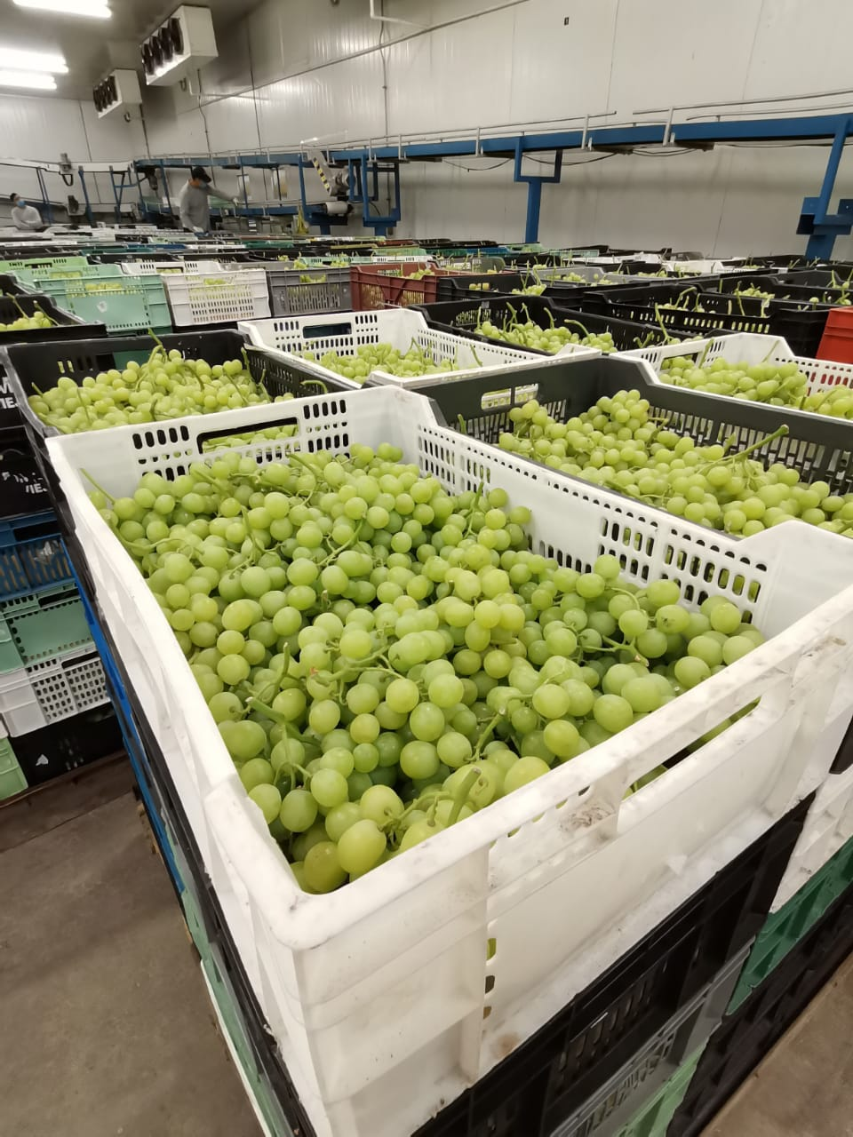
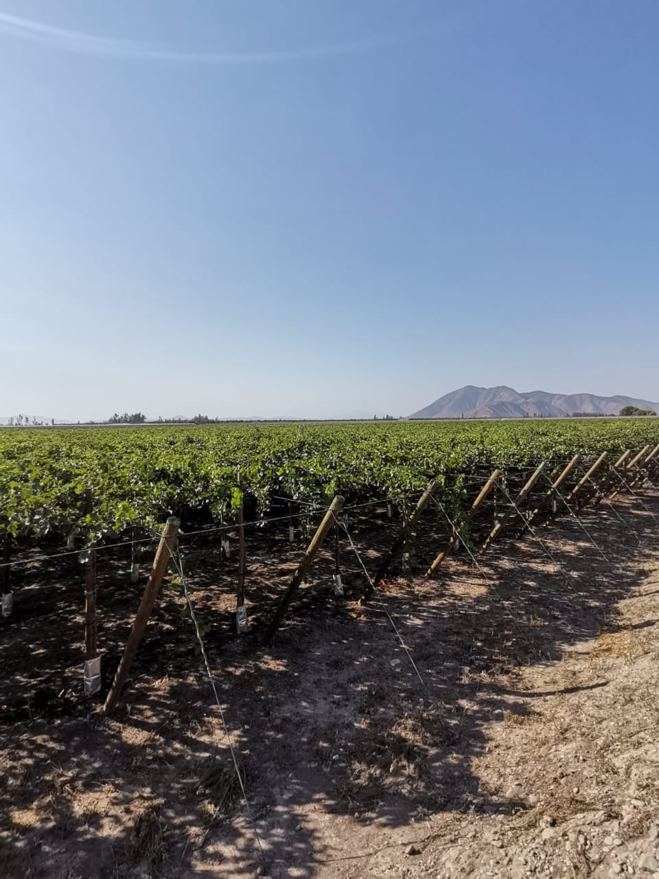
Motivation
<number>
Source: Carmen Rosa company
Source: Carmen Rosa company

Slide 3
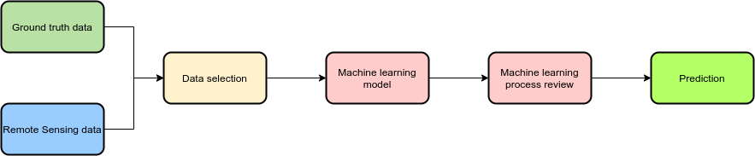





Workflow
<number>

Slide 4
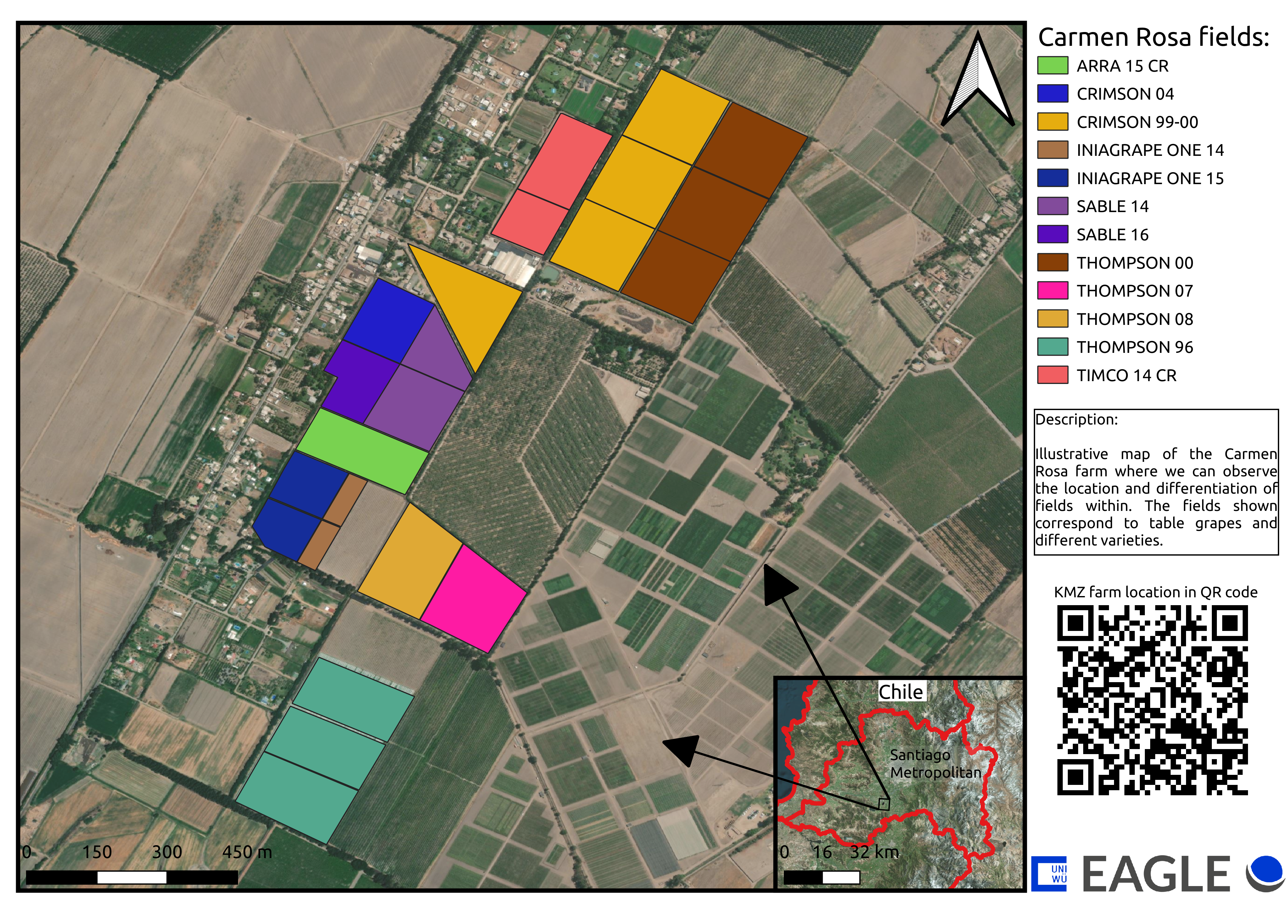
Area of study
<number>
Figure 1: Map Carmen Rosa farm.

Slide 5
Ground truth data - Production
<number>
 |  | Year | 13-14 | 14-15 | 15-16 | 16-17 | 17-18 | 18-19 | 19-20
Variety | Field | Surface (He) | Total Kg produced by He | Total Kg produced by He | Total Kg produced by He | Total Kg produced by He | Total Kg produced by He | Total Kg produced by He | Total Kg produced by He
THOMPSON | THOMPSON 00 | 9.60 | 38,225 | 50,364 | 36,898 | 37,556 | 42,209 | 31,974 | 37,808
THOMPSON | THOMPSON 07 | 3.40 | 21,401 | 58,425 | 41,733 | 35,366 | 37,818 | 27,008 | 38,151
THOMPSON | THOMPSON 08 | 3.40 | 12,361 | 50,571 | 43,396 | 41,152 | 47,094 | 30,372 | 34,098
THOMPSON | THOMPSON 96 | 9.50 | 15,321 | 52,965 | 35,357 | 32,043 | 39,654 | 27,944 | 36,523
CRIMSON | CRIMSON 99-00 | 12.20 | 61,652 | 48,716 | 40,552 | 58,012 | 48,920 | 53,385 | 52,420
CRIMSON | CRIMSON 04 | 2.40 | 64,986 | 58,127 | 45,277 | 57,662 | 45,585 | 61,284 | 52,501
ARRA | ARRA 15 CR | 2.90 |  |  |  | 22,311 | 45,286 | 53,119 | 44,983
TIMCO | TIMCO 14 CR | 4.10 |  |  |  | 13,510 | 48,340 | 50,073 | 74,931
INIAGRAPEONE | INIAGRAPE ONE 14 | 1.1 |  |  | 6,968 | 31,768 | 56,279 | 46,748 | 24,633
INIAGRAPEONE | INIAGRAPE ONE 15 | 3.0 |  |  |  |  |  | 47,891 | 26,805
SABLE | SABLE 14 | 4.2 |  |  | 8,551 | 21,504 | 36,082 | 34,794 | 50,315
SABLE | SABLE 16 | 1.9 |  |  |  |  |  | 8,711 | 40,520
Table 1: Data provided by Carmen Rosa Farm

Slide 6
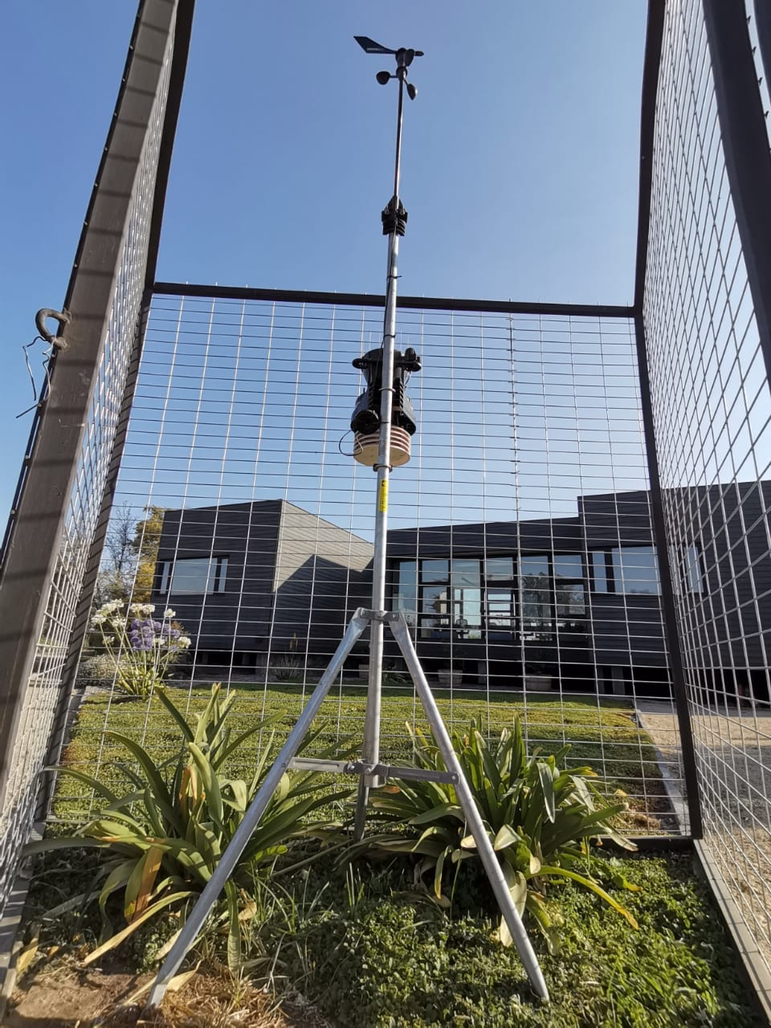
Ground truth data - Weather station
<number>
Temperature
Evapotranspiration
Humidity
Fields area
Grade day
Annual production
Source: Carmen Rosa company

Slide 7
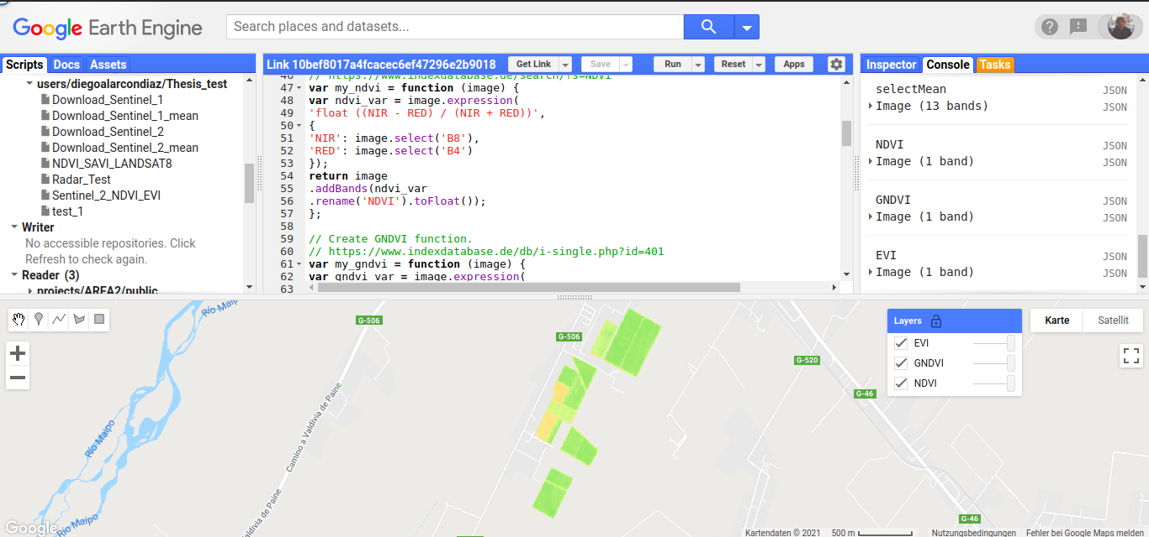
Remote Sensing data - GEE
<number>
Figure 1: Bloom's Cognitive Domain (Benitez 2012)
Source: Google.com

Slide 8
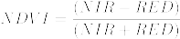
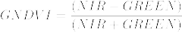
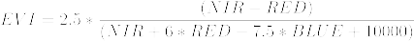
Remote Sensing data - Index
<number>

Slide 9
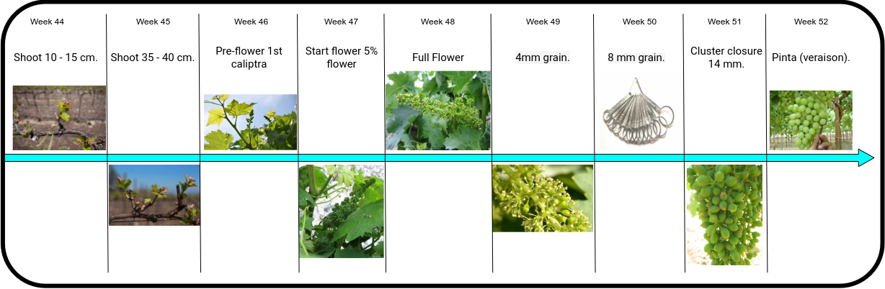
Phenological state
<number>

Slide 10
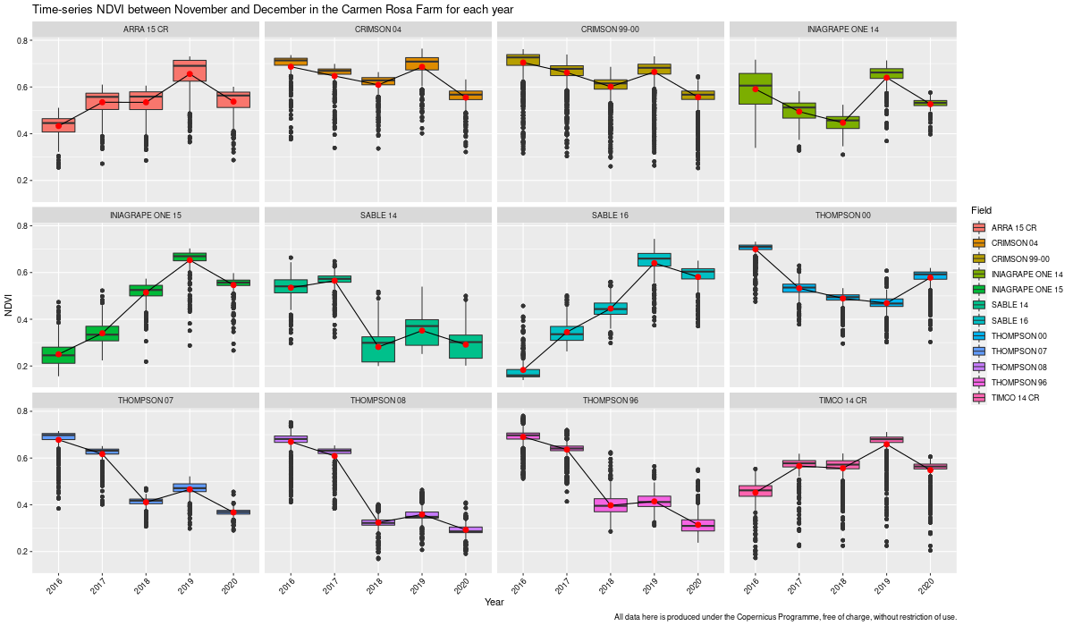
Analysis NDVI
<number>
Figure 2: NDVI analysis phenologycal stage between years 2016 -2020
*For the fields 'INIAGRAPE ONE 15' and 'SABLE 16', only the years 2018 to 2020 are valid.
*The other data was removed from the data frame to create the machine learning model.

Slide 11
Analysis Machine Learning – Model parameter
<number>

Slide 12
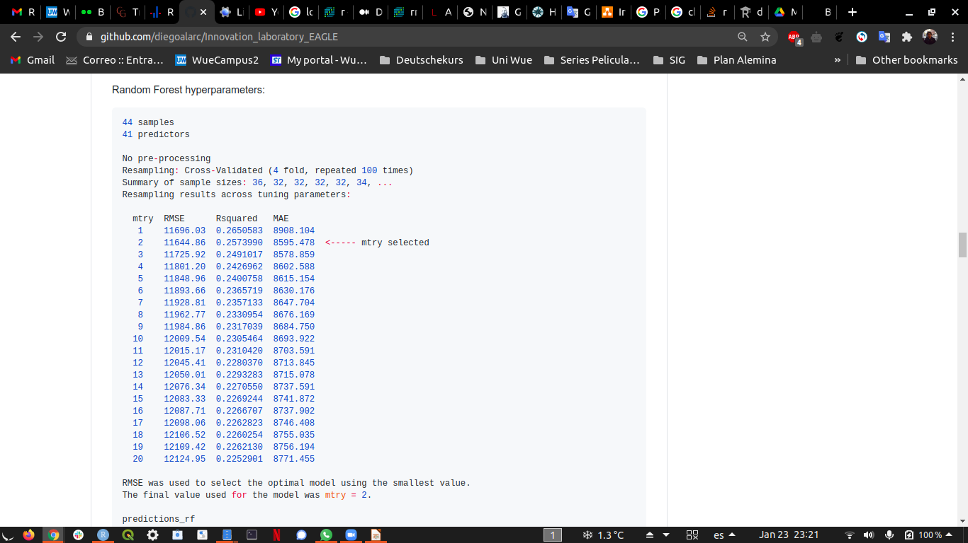
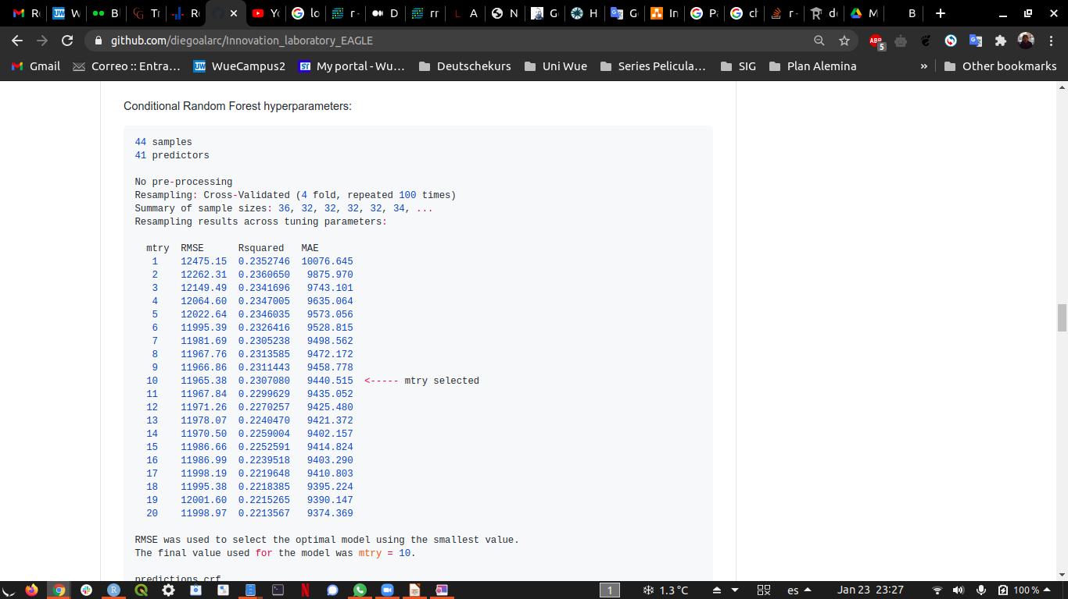
Analysis Machine Learning - Model
<number>
Random Forest
Conditional Random Forest
Figure 3: Information machine learning model generated

Slide 13
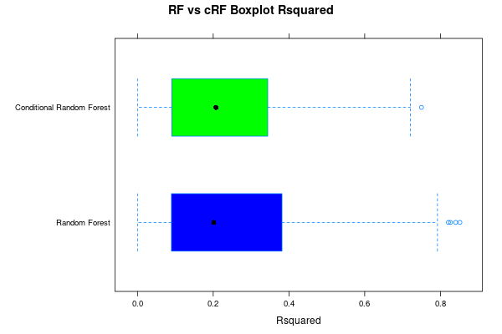
Analysis Machine Learning - Model
<number>
Figure 4: Rsquared comparison between RF and cRF models produced

Slide 14
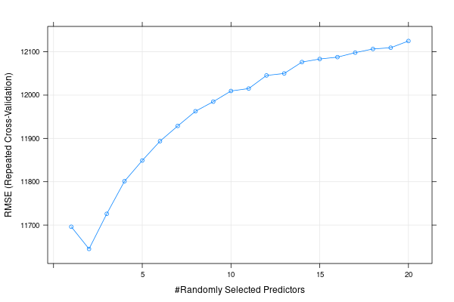
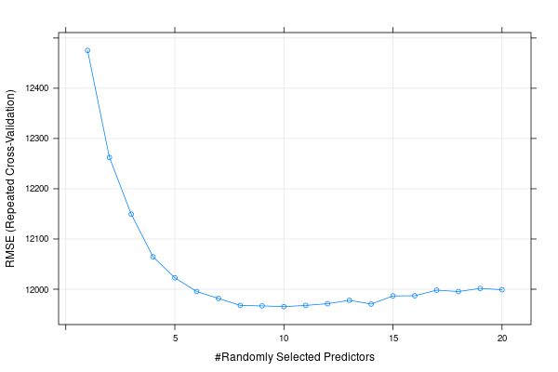
Analysis Machine Learning - Model
<number>
Random Forest
Conditional Random Forest
Figure 5: RMSE comparison between RF and cRF mtry cross validation

Slide 15
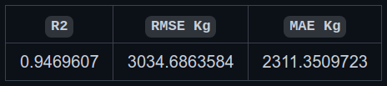
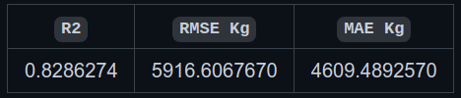
Analysis Machine Learning - Model evaluation
<number>
Random Forest
Conditional Random Forest
Figure 6: Comparison between RF and cRF using validation data

Slide 16
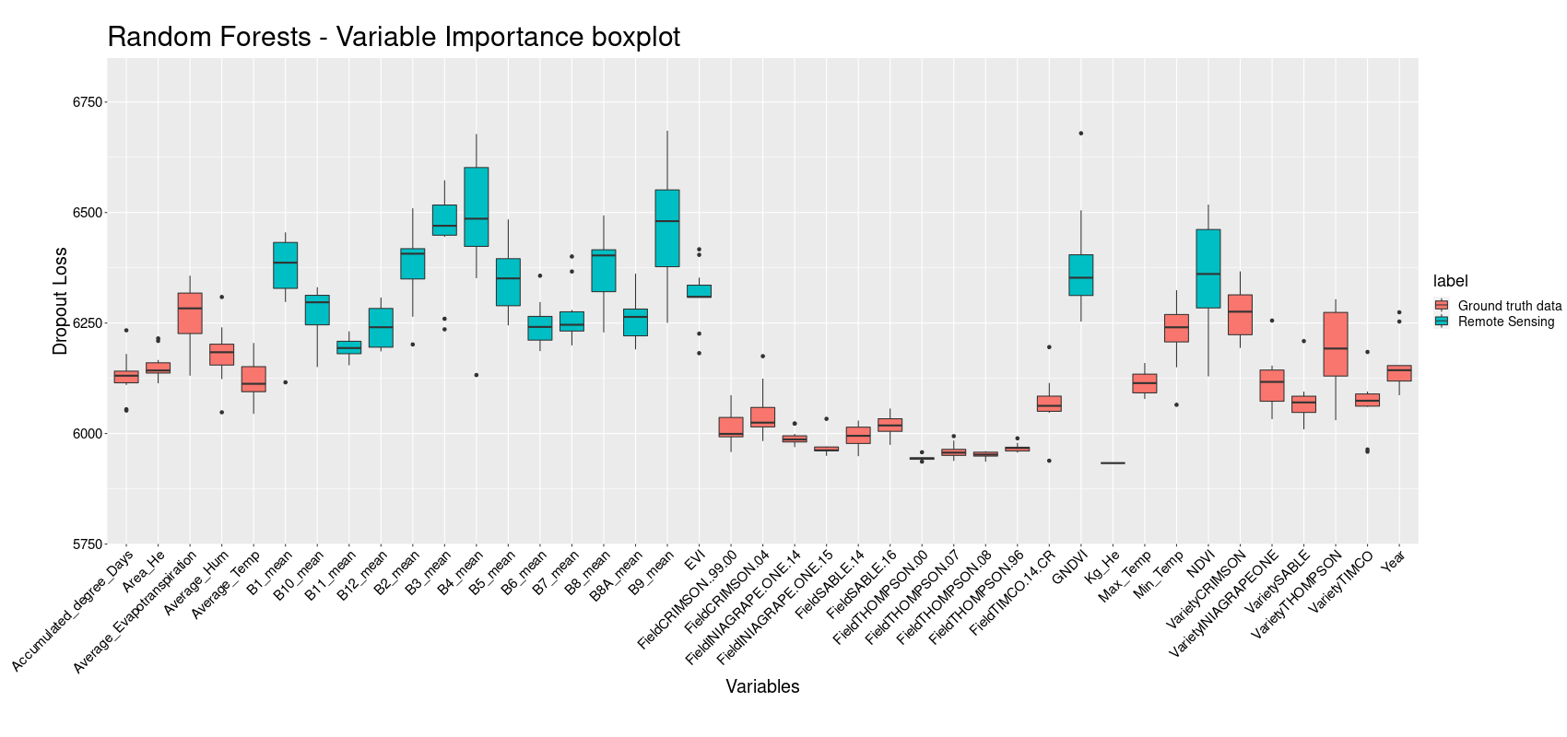
Analysis Machine Learning - Variable
<number>
Figure 7: Variable importance Random Forest

Slide 17
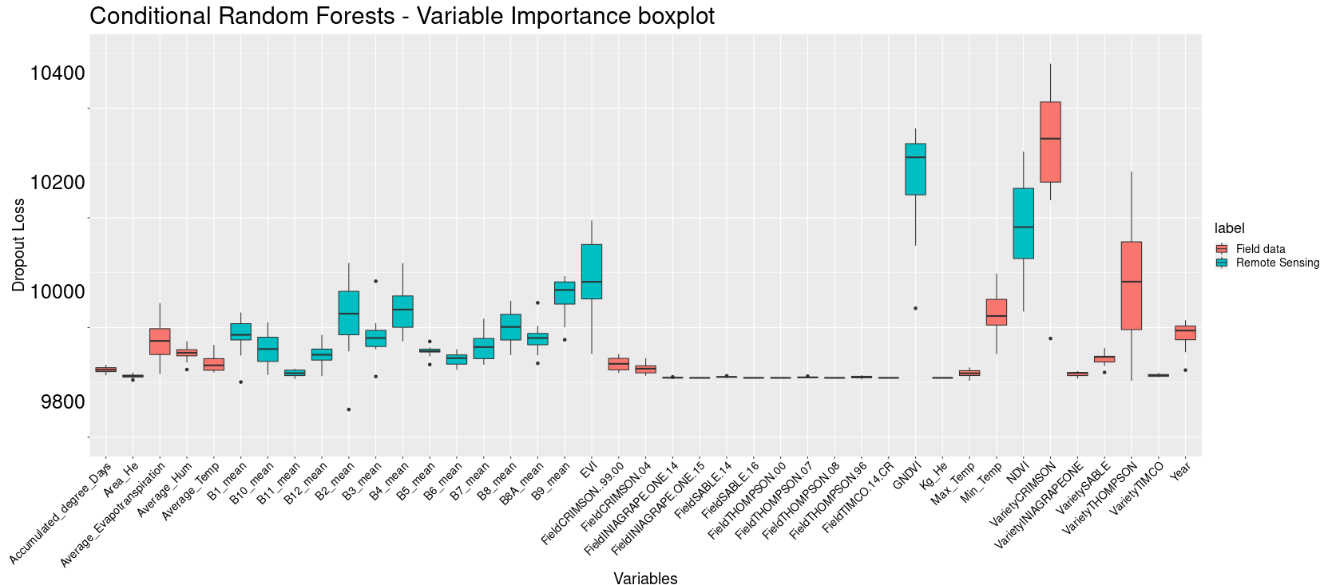
Analysis Machine Learning - Variable
<number>
Figure 8: Variable importance conditional Random Forest

Slide 18
Results
<number>
Random Forest
Variety | Field | Year | Area_He | Kg_He
THOMPSON | THOMPSON 00 | 2021 | 9.6 | 41357.7977096304
THOMPSON | THOMPSON 07 | 2021 | 3.4 | 36689.4504366268
THOMPSON | THOMPSON 08 | 2021 | 3.4 | 35831.9454180071
THOMPSON | THOMPSON 96 | 2021 | 9.5 | 35798.0735234639
CRIMSON | CRIMSON 99-00 | 2021 | 12.2 | 45890.9988594843
CRIMSON | CRIMSON 04 | 2021 | 2.4 | 47082.2595503199
ARRA | ARRA 15 CR | 2021 | 2.9 | 44344.6312243955
TIMCO | TIMCO 14 CR | 2021 | 4.1 | 43648.8121403448
INIAGRAPEONE | INIAGRAPE ONE 14 | 2021 | 1.1 | 42528.3456174134
INIAGRAPEONE | INIAGRAPE ONE 15 | 2021 | 3 | 42693.726853647
SABLE | SABLE 14 | 2021 | 4.2 | 36598.9735786702
SABLE | SABLE 16 | 2021 | 1.9 | 40690.0046396989
Table 2: Data predicted by the Random Forest model

Slide 19
Results
<number>
Conditional Random Forest
Variety | Field | Year | Area_He | Kg_He
THOMPSON | THOMPSON 00 | 2021 | 9.6 | 40630.3478980829
THOMPSON | THOMPSON 07 | 2021 | 3.4 | 35272.6115914895
THOMPSON | THOMPSON 08 | 2021 | 3.4 | 35009.3554826691
THOMPSON | THOMPSON 96 | 2021 | 9.5 | 34895.3375997666
CRIMSON | CRIMSON 99-00 | 2021 | 12.2 | 44551.796429587
CRIMSON | CRIMSON 04 | 2021 | 2.4 | 45011.1310551689
ARRA | ARRA 15 CR | 2021 | 2.9 | 42912.3193929731
TIMCO | TIMCO 14 CR | 2021 | 4.1 | 42191.3154600087
INIAGRAPEONE | INIAGRAPE ONE 14 | 2021 | 1.1 | 41554.7408015287
INIAGRAPEONE | INIAGRAPE ONE 15 | 2021 | 3 | 41840.732953901
SABLE | SABLE 14 | 2021 | 4.2 | 35848.9520325514
SABLE | SABLE 16 | 2021 | 1.9 | 43400.768352273
Table 3: Data predicted by the conditional Random Forest model

Slide 20
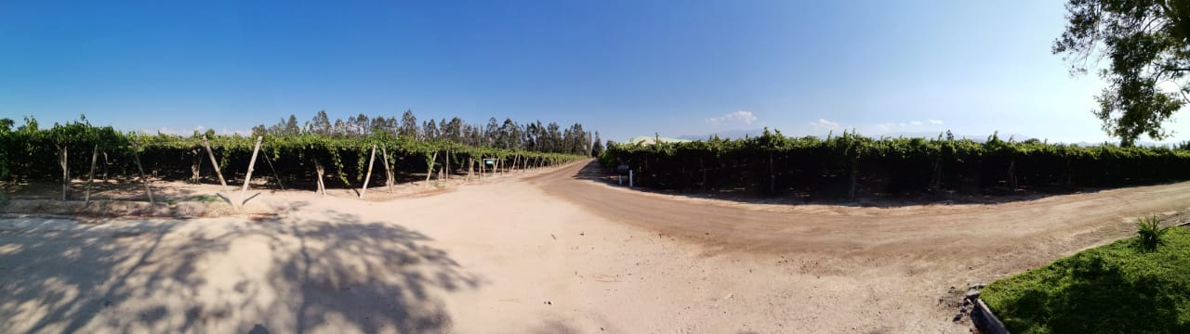
Results
<number>
Use of Machine Learning
Variables interpretation (RS & Field data)
Yield forecasting
Source: Carmen Rosa company

Slide 21
Conclusions
<number>
Number of observations (deep analysis size sample).
Random Forest best performance.
Yield in the next months of February and March 2021.
Remote Sensing data is really important for the model (VarImp).

Slide 22
Outlook
<number>
Possible improvement with SAR data (Time-Series).
Increase observations size.
Reproduction in other coding languages (as Python).
Include other Vegetation Index (for testing).

Slide 23
Bibliography
<number>
Gitelson, A.A.; Kaufman, Y.J.; Merzlyak, M.N. Use of a green channel in remote sensing of global vegetation from EOS-MODIS. Remote Sens. Environ. 1996, 58, 289–298.
Xia, Rong, "Comparison of Random Forests and Cforest: Variable Importance Measures and Prediction Accuracies" (2009). All Graduate Plan B and other Reports. 1255. https://digitalcommons.usu.edu/gradreports/1255
Crane-Droesch, Andrew. (2018). Machine learning methods for crop yield prediction and climate change impact assessment in agriculture. Environmental Research Letters. 13. 10.1088/1748-9326/aae159.
Braga, Dieinison & Coelho da Silva, Ticiana & Rocha, Atslands & Coutinho do Rêgo, Luís Gustavo & Pires Magalhaes, Regis & Guerra, Paulo. (2020). Time Series Forecasting to Support Irrigation Management. Journal on Data Semantics. 10. 66-80.
Zhao, Yan & Potgieter, Andries & Zhang, Miao & Wu, Bingfang & Hammer, G.. (2020). remote sensing Predicting Wheat Yield at the Field Scale by Combining High-Resolution Sentinel-2 Satellite Imagery and Crop Modelling. Remote Sensing. 12. 10.3390/rs12061024.
Pantazi, X.E. & Moshou, Dimitrios & Alexandridis, Thomas & Whetton, Rebecca & Mouazen, Abdul. (2016). Wheat yield prediction using machine learning and advanced sensing techniques. Computers and Electronics in Agriculture. 121. 57-65. 10.1016/j.compag.2015.11.018.
Al-Gaadi, K.A. & Hassaballa, Abdalhaleem A. & Tola, Elkamil & Kayad, Ahmed & Madugundu, Rangaswamy & Alblewi, Bander & Assiri, Fahad. (2016). Prediction of Potato Crop Yield Using Precision Agriculture Techniques. PloS one. 11. e0162219. 10.1371/journal.pone.0162219.
Breiman L (2001). Random Forests. Machine Learning, 45(1), 5–32.
Hothorn T, Hornik K, Zeileis A (2006b). Unbiased Recursive Partitioning: A Conditional Inference Framework. Journal of Computational and Graphical Statistics, 15(3), 651–674.
Kuhn, M. (2008). Building Predictive Models in R Using the caret Package. Journal of Statistical Software, 28(5), 1 - 26. doi:http://dx.doi.org/10.18637/jss.v028.i05
Wickham H (2016). ggplot2: Elegant Graphics for Data Analysis. Springer-Verlag New York. ISBN 978-3-319-24277-4, https://ggplot2.tidyverse.org.
Wickham et al., (2019). Welcome to the tidyverse. Journal of Open Source Software, 4(43), 1686, https://doi.org/10.21105/joss.01686

Slide 24
<number>
Thanks for your attention!!!
https://github.com/diegoalarc/Innovation_laboratory_EAGLE
Questions?

